Slide 1
You
Your Presentation
...and PowerPoint
Frank Widman
Training & Development
Notes:
Anybody here in 4-H?
Anybody here have Mr. Airoldi for World History in 9th grade?
Anybody ever have to deliver a presentation using PowerPoint?
How’d it go?
You can create a powerful and compelling presentation utilizing 3 areas of approach:
Understand the dynamics of your mind and body
Take 7 steps to create your presentation
Use PowerPoint as an effective tool for your presentation
By following through these 3 approaches, you will become an effective and engaging presenter,enhancing your communication skills and increasing your audience’s body of knowledge.

Slide 2

How to deal with your energy
How to put the presentation together
How to make PowerPoint work for you
Notes:
Deal with your energy
So often our energy gets used up in the stress of the situation and it doesn’t get put towards communicating your information.
We’ll focus on your body and mind to release tension, focus on the audience and engage in good communication
Put a presentation together
T&D offers a course on “Delivering Dynamic Presentations”, and I want to give you the heart of the class by pointing to a 7-step method of creating a presentation.
Using PowerPoint
We are going to look at why audiences disengage from a presentation the moment they see you are using PowerPoint, and who can blame them?
I’ve got 10 tips from a fellow named Garr Reynolds that will help you focus your information on your audience and not on the screen.
Before we get into these 3 areas, I want to point to a couple of themes that will be an undercurrent to today’s session. You don’t have to memorize them, but it would be great if you could start to be mindful of them.
The first theme was inspired by John Medina is the author of Brain Rules, a book about 12 principles “for surviving and thriving at home, at work and at school”. The 12 principles come from brain research and get applied to how we as humans behave.

Slide 3
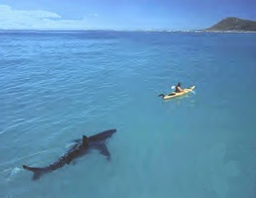


We don’t pay attention to boring things
Stimulate more of the senses
Vision trumps all other senses
Notes:
Start to be mindful of 3 of these principles when you make a presentation:
We don’t pay attention to boring things
Stimulate more of the senses
Vision trumps all other senses
I am a firm believer that “emotionally arousing events tend to be better remembered than neutral events.” I’ll start to talk about how an emotion can carry learning deeply into the brain.
The more the brain pays attention to a given stimulus, the more elaborately the information will be encoded and retained.

Slide 4
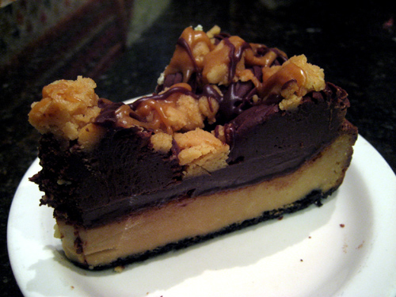


Restraint
Simplicity
Naturalness
Notes:
The other theme that will float through today’s session is the approach that Garr Reynolds takes when he creates a presentation. He bases this approach on some of the principles of Zen Buddhism:
Restraint--the 80% idea
Simplicity--allow the brain to fill in the blanks
Naturalness--you need to be yourself
As we go through this session, I will try to refer back to these themes when we look at dealing with your energy, creating the presentation and making PowerPoint an effective tool.

Slide 5
You
How composed and confident do you feel?
Notes:
So where do we start? How about with you.
What kind of presentations do you give?
How do they go over?
How do you think you did?

Slide 6
Can you order the list of the…
10 Worst Human Fears?
Flying
Loneliness
1.
Death
2.
Financial Problems
3.
4.
Speaking Before a Group
5.
Dogs
6.
Insects and Bugs
7.
Sickness
8.
Heights
9.
Deep Water
10.
Notes:
Ok everyone, which fear is #1?

Slide 7
Can you order the list of the…
10 Worst Human Fears?
Flying
Loneliness
1.
Speaking Before a Group
Death
2.
Heights
3.
Insects and Bugs
Financial Problems
4.
Financial Problems
Speaking Before a Group
5.
Deep Water
Dogs
6.
Sickness
Insects and Bugs
7.
Death
Sickness
8.
Flying
Heights
9.
Loneliness
Deep Water
10.
Dogs
Notes:
The fear of speaking before a group. Death comes in at #7.
Before you can engage your audience, you need to engage yourself. You need to be prepared and relaxed. Ha! Easier said than done, right?

Slide 8

8 Tips for Reducing Anxiety
Organize
Visualize
Practice
Breathe
Focus on relaxing
Release tension
Move
Make eye contact
Notes:
Here’s 8 suggestions to get yourself in front of everybody and engage them.
Organize-John Medina’s research shows that the brain likes to go from generalities to specifics. We’ll talk later about getting your core concepts together and then giving the details
Visualize-like an athlete before an event…mentally picture your whole presentation, including details
Practice-don’t do it mentally, do it for real…in front of a friend, a mirror, video yourself
Breathe-if you’re anxious, your muscles tighten and you’re not breathing deeply enough. John Medina says the brain is an oxygen hog…it represents 2% of body weight and 20% of the body’s energy usage. Let’s do a breathing exercise.
Focus on relaxing-inhale “I am” exhale “relaxed”, tense and release exercise, QiGong moon and sun exercise if there is time
Release tension-shake out before you go on
Move-as an actor I learned “take an action to release emotion”…it’s a good idea to move from behind the podium anyway
Make eye contact-try it with people who are smiling at you first…make sure you cover the whole room, in fact, let’s talk about how our body can be an asset to delivering that dynamic presentation….

Slide 9



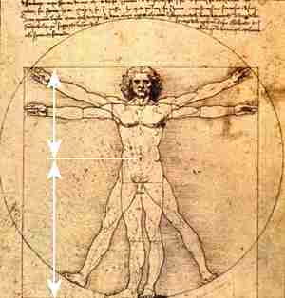
Dealing with your energy
Notes:
Anxiety is normal when a person is placed in a stressful situation. It manifests itself through your:
Eyes
Hands
Feet
Body
Voice
Let’s consider how these 5 body parts can put you to your presentation’s advantage.

Slide 10

The most powerful way to convey energy
Notes:
Convey credibility, authority, interest and involvement
Reduces your nervousness
Make eye contact for 3-5 seconds
Your eyes are truly the most important communicators. Your audience absorbs a huge amount of information from your eyes alone.
Therefore it is essential to make eye contact with your audience.
If you are speaking to a large audience, make contact with an audience member in one area, and those around them will feel you are contacting them as well.
Make sure you make contact in all areas of your audience. The longer you make eye contact, the more self-esteem you are perceived to have.
Albert Mehrabian’s communication model shows that the meaning of what is spoken:
7% Spoken word
38% Paralinguistic (the way words are said)
55% Facial expression
So non-verbal communication is highly important in conveying feelings and attitude.

Slide 11

Experiment with exaggerating your gestures
Notes:
Gestures support your message
Use hands to show shape, size, movement and spatial relationships
Find a neutral place
Exaggerate your gestures, watch out for pointing, use an open palm
Your hands can also be your worst enemy…why?
It’s important then to let your gestures happen naturally
Using gestures may take some practice.
There is always a question of a gesture being too much or too little.
Try to make the gesture come from the center of your body so what you say and what motion is used are tied closely together.
Try your presentation in front of someone you trust. They will let you know if the gesture is too much.
Remember, jingling coins in your pockets or straightening your hair are not considered effective gestures.

Slide 12

Move with a purpose
Notes:
Plant your feet
Evenly balanced
10-12 inches apart
Move for a reason
Watch distracting habits like rocking, tapping feet, drifting around
If your feet are planted firmly on the floor,
balanced and relaxed, the rest of your body is going to follow them, including your voice.
Before you present your topic, you might want to try a relaxation exercise that allows you to relax each part of your body starting with your feet and moving up through your head.
Some people find themselves swaying to a rhythm.
Save it for the dance floor.
If your feet are planted firmly on the floor,
balanced and relaxed, the rest of your body is going to follow them, including your voice.
Before you present your topic, you might want to try a relaxation exercise that allows you to relax each part of your body starting with your feet and moving up through your head.

Slide 13
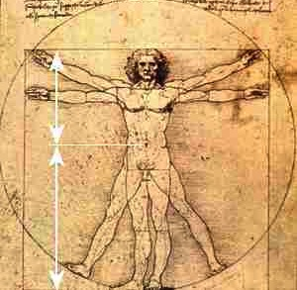
Dress appropriately
Notes:
Stand up straight
Shoulders back
Align hips over knees and feet
Keep gestures above your waist
Dress appropriately
Try to keep from shuffling, swaying, or making robotic movements with your body.
If you find yourself needing to move, incorporate the movement with what you are saying.
Sometimes by committing to a movement, it will help you to make your point.
If you can get away from the podium, it is helpful to communicate with your whole body.
When you are aware of your whole body, your whole body is going to help communicate your message.
Try to keep from shuffling, swaying, or making robotic movements with your body.
If you find yourself needing to move, incorporate the movement with what you are saying.
Sometimes by committing to a movement, it will help you to make your point.
If you can get away from the podium, it is helpful to communicate with your whole body.

Slide 14
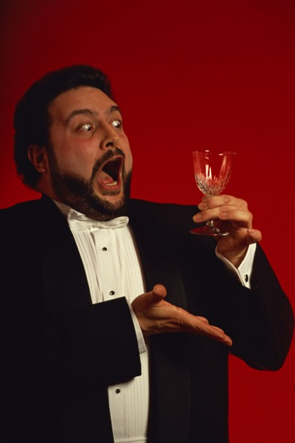
Practice!
…and remember…
spoken English and written English are not the same.
Notes:
Pace
Inflection (Emphasis)
Tone (Attitude)
Volume
Non-words
Learn to breathe from your diaphragm.
It will help with the nervousness that is felt in the solar plexus.
Diaphragmatic breathing will help slow down the tendency to speak rapidly.
You will need to practice in order to control the qualities of your voice, and there are many books and classes available on developing your voice.
But the most basic way to start, is to hum.
Start softly, feel where you are resonating with your hum and then start speaking. Practicing this basic technique will give your voice a natural place to start making sound that won’t strain it. The more relaxed you are, the more natural your voice will sound.
The quaver in your voice will disappear if you increase your vocal volume.

Slide 15
You
The Presentation
Notes:
So enough about you…let’s look at how to put together the presentation
Here’s a 7-step plan that we teach in our delivering dynamic presentations class.
While we examine these steps, let’s be mindful of our Zen approach:
Restraint
Simplicity
Naturalness

Slide 16
Preparing Your Presentation
Analyze your audience
Develop Objective and Position-Action-Benefit statement
Brainstorm main ideas
State the subpoints
Develop introductions and conclusions
Formulate the main idea preview/review sentence
Develop slides or other visual aids
Notes:
Here they are. I’ll dwell briefly on them today, but you’ll be able to go online and buy the book we use in the class. I’ve got links at the end of the presentation. In fact the whole presentation will be available for download after this session.
My guess is that you’ve done most if not all these steps if you’ve had to present in the past. Writing an essay in your English class involved this process.
This process was designed to be easy. Putting them all together is going to help give you a dynamic presentation.

Slide 17

Step 1: Analyze your audience
Demographics
Needs
Attitude
Knowledge level
Environment (physical, psychological)
Notes:
Note to self: it’s not about you!…it’s all about your audience!
As a presenter, why do you want to learn as much as possible about your audience?
Demographics: Who will attend?
(Job functions and tenure; size of audience; do they know each other? Age, sex, economic status, culture, occupation, ethnic background, level of education, ability to speak and understand English, etc.
Needs: What are their expectations & needs?
What are their needs and objectives for the presentation? Are they different from yours? What are the important topics or issues they want to listen to?
Attitude: How do they feel about the topic?
Positive? Negative? Neutral? Mixed? No clue? Remember that emotional content is going to learning deeper…we don’t pay attention to boring things
Knowledge level: How much do they know about this topic? Anxiety note: when you think the audience is more knowledgeable than you
Depth of knowledge; appropriateness of jargon, acronyms.
Environment: Is there anything that will affect their receptivity and your success?
Physical/Psychological environment.

Slide 18

Step 2: Develop Objective and Position-Action-Benefit
What do you want to accomplish?
Notes:
You can even do this out loud…ask yourself this question…
“What do I want to accomplish?”
The answer to the question is your objective.
“I want to cultivate powerful and compelling presentation skills.”
Your objective could involve a change in behavior, attitude or action.

Slide 19




Step 2: Position-Action-Benefit
What is your opinion?
What do you want your audience to do?
What’s in it for them?
Notes:
Once your objective is developed, then it’s time to formulate your
Position…taking a stand, stating an opinion, telling your audience what you personally think about your topic.
It needs to be clear and succinct (think Zen: restraint, simplicity, naturalness)
It is told at the outset of your presentation
Action…behavior change, attitude change, new depth of knowledge
Actions need to be specific, achievable and usually have a time frame attached
Benefit…what your audience always asks, maybe not consciously, but it’s about
Money
Time saved
Self-improvement
Anxiety note: “so show me” “prove it”
In order to come up with your Position-Action-Benefit, you may need to…

Slide 20

Step 3: Brainstorm Main Ideas
Go for quantity
Don’t censor
2-5 main ideas
Notes:
A typical dynamic presentation contains 2-5 main ideas. These would be what John Medina calls the meaning before the details.
Brainstorming calls for you to generate as many ideas as possible. You’ll pare them down later. Some of these ideas could become the details of the main idea. The point now is to open yourself up to everything. You may want to brainstorm with a colleague.
Edward Tufte says:
Assume your audience is intelligent
To clarify, add detail…not necessarily on the slide
Graphics are “intelligence made visible”
Once you’ve brain-stormed, then…

Slide 21
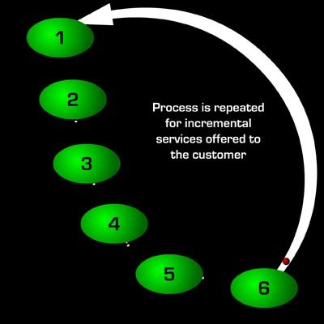
Step 4: State the Subpoints
Evidence
Supporting ideas
Logical flow
Notes:
Produce your evidence, give the details, you may need to shuffle the deck to get the logical flow
John Medina developed the 10 minute rule in his microbiology lectures:
I’m given an hour to lecture…my students tune out after 10 minutes, most people do, so…
In that one hour I can get in 5 ten-minutes chunks of information, so I deliver my Main Idea and state the subpoints, the detail…for 10 minutes…at which time I send out an Emotionally Compelling Stimulus as a hook that triggers emotion and captures attention. The Emotionally Compelling Stimuli needs to be relevant to my main topic and it is placed either at the end of my detail or at the beginning of the next main point.
Remember a theme:
We don’t pay attention to boring things
Stimulate more of the senses
Vision trumps all other senses
Remember: Restraint, Simplicity, Naturalness

Slide 22
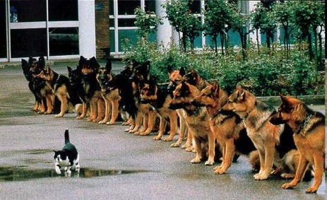

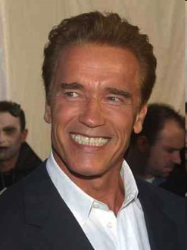

Step 5: Develop Introductions and Conclusions
Get their attention
Create rapport
Build Credibility
Describe what you’re talking about
Notes:
Compelling introductions help keep a memory stored in the same place that perceives a learning event.
These are all possible attention-getters or the Emotionally Compelling Stimulus
Anecdotes-the value of story telling…everyone loves a good story
Humor-be careful, don’t crack a joke just for the joke…relevance, restraint
Question: Involving or Rhetorical..the safe bet is a show of hands, rather than an open question that could result in unwanted humor from the comedian in the crowd
Shocking statement/statistic
Quotation-be brief, OK to read it, cite the source
Your introduction could also be your Position-Action-Benefit statement, especially if you’re delivering something highly opinionated. Your PAB needs to be restated in your conclusion, speaking of which…

Slide 23


Step 5: Conclusions
Notes:
Make a final impression
Provide closure
Summarize
“In summary …”, in other words cue the audience that you’re ending
Refer to Position-Action-Benefits statement…remember, you want to change their behavior. Now is the time to remind them. You are calling them to action.
End strongly…you may want to write out your conclusion…maintaining simplicity, restraint, naturalness...
Keep it undertime not overtime! People will think highly of you because you saved them time.

Slide 24
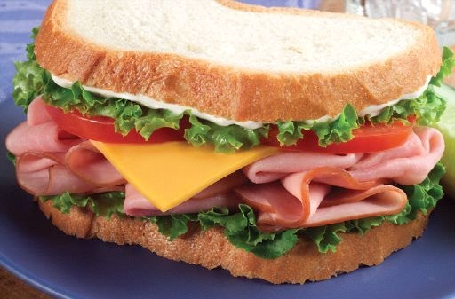
Step 6: Formulating the Main Idea Preview/Review Sentence
Tell them what you’re going to tell them –
Tell them –
Then, tell them what you told them.
Notes:
The preview sentence is part of the introduction. “I want to talk about how you can deliver effective presentations.” You should follow the preview sentence with a written or verbal agenda.
The review sentence summarizes what you told them in the body of your presentation. It’s a kind of segue to the review of your Position-Action-Benefit statement. “Today’ presentation has been an overview of how you can best deliver a presentation.”

Slide 25



Step 6: Formulating the Main Idea Preview/Review Sentence
Introduction…including the opener and the PAB Statement
Preview sentence
Main ideas and sub-points
Review sentence
Conclusion
Notes:
Sequence of Delivery
1. Introduction (Opener and/or P-A-B)…the first slice of bread
2. Preview sentence (Verbal/Written Agenda)…let’s say it’s the mustard on the first slice of bread
3. Main ideas and subpoints (Body)…the peanut butter and jelly, the ham and cheese, the pastrami and sourkraut
4. Review sentence: “In summary …” (Begins conclusion)…will call it the mayo, although my wife cringes at mayo with the pastrami and sourkraut
5. Conclusion (Restate P-A-B)…the other slice of bread
I think I need a bromo….

Slide 26

Step 7: Develop Slides or Other Visual Aids
We’ll
tawlk
Notes:
We’re going to tawlk about PowerPoint next, but do consider handouts as well.
Handouts:
reinforce important information
summarize action items
supply supporting data that you don’t want on your slides!
Consider when you want to hand out your handouts

Slide 27
You
Your Presentation
...and PowerPoint
Notes:
And now…
it’s time for Behavior Modification 101!
How do you most effectively use PowerPoint.
Let’s look at some slides….

Slide 28
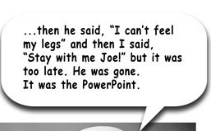

PowerPoint
Notes:
Sometimes the best presentation is... no presentation. Ditch the slides completely. Put the projector in the closet, roll the screen back up, and turn the damn lights back on! …
It’s about your audience.
It’s about you communicating information.
PowerPoint is a visual aid meant for increasing the understanding of your audience. It’s not meant to be your cue card.
Remember to keep asking yourself…does the information on this slide fulfill my objective?

Slide 29
Anxiety Disorders
Generalized Anxiety Disorder
  Excessive worry in general
Obsessive-Compulsive Disorder
  Consuming fixation and ritualistic behaviors
Panic Disorder
  Overwhelming physiological event
Social Phobias
  Incapacitating fear of social interactions
Specific Phobias
  Intense fear of specific object, event
Notes:
Objective of this presentation…to give the audience an anxiety disorder.
I can hear some of you saying, “they’re just bullet points”... Or worse….

Slide 30

By collecting millions of detailed records about NHS hospital treatment since 1989, HES is in a unique position to illustrate trends, reveal changes brought about by central directives, and show the effects of developments in medical science.
The graph below gives an idea of the huge volume of hospital activity during the decade 1995-96 to 2004-05, and shows some trends in key measures. All inpatient care (including day case surgery) is included, but not outpatient attendances or visits to A&E departments where the patient is sent straight home after treatment.
Admissions have increased by almost 2 million (18.6 per cent), but the average length of stay in hospital (excluding day cases) has dropped nearly 3 days. This implies that the overall bed occupancy - and therefore the number of available beds - has not changed significantly.
The rise in the average age of admitted patients from 45 to 49 years is almost certainly due to increased longevity, and raises questions about the additional resources needed to tackle problems caused by an ageing population.
Notes:
Paragraphs
Whose text color matches the background “art”

Slide 31
PowerPoint
"Is PowerPoint bad? No, in fact, it is quite a useful tool. Boring talks are bad. Poorly structured talks are bad. Don't blame the problem on the tool."
Don Norman
Author of
The Design of Everyday Things
Notes:
Restraint…Simplicity…Naturalness
Many experts recommend the 5/5 rule, that becomes the 7/7 rule, that still tends to put bullet points on every slide. Ask yourself, “is this slide necessary?” There is always fat…find it and trim it…

Slide 32


PowerPoint
Fresh
Fish
Sold
Here
Fresh
Fish
Sold
Here
Fresh
Fish
Sold
Here
Fresh
Fish
Sold
Here
Notes:
The Fresh Fish Rule
Many people struggle with boiling down their words to fit onto a slide to obey the ruthless dictates of the rule of five. To do this it is worth remembering what we have come to call the Fresh Fish Rule. This was first taught me by a Glaswegian sub-editor when many, many years ago I was a down-table sub-editor at BBC Broadcasting House in London. He told me of a sign which exists to this day on a shop wall in the village of Stockbridge in Hampshire. The sign simply said ‘Fresh Fish Sold Here.’ He asked me what was wrong with that sign. I replied, “Nothing”. He insisted it was too long and asked me which was the most redundant word that could be removed without changing the sign’s impact. The answer, of course, was ‘Here.’ After all, who puts a sign up unless they are selling something at that particular location?
He then asked for the next most redundant word, which was ‘Sold’ – not many people go to the trouble of creating a sign unless they are actually selling something. The next most redundant word is ‘Fresh’ because it’s a given that you’re not selling rotten fish. Well I got all of this right, but my Glaswegian sub-editor was not satisfied. He said “You dunna need fish ‘cuz you can smell it half a mile away!"
The Fresh Fish rule serves to illustrate how words can be reduced, but in this particular instance much better than words would have been a picture of a fish.

Slide 33

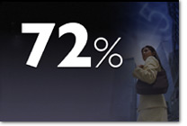
PowerPoint
And this is even better...
Aim for something like this simple slide.
Notes:
We are noting simplicity and to assist that simplicity is how pictures help to guide the audience through your presentation. They need to be easy to see.
Showing people meaningful, content-based visuals, as opposed to text.
Text lessens their cognitive exertion and improves overall experience.
Pictures provide:
Provide Detail
Shape Emotions
Lay Down Context:
Simplify or Clarify Complexity
Give Examples
Reduce Learning Times
Enhance Verbal Stories
Improve Memory Recall
Remember: Restraint, Simplicity, Naturalness
Remember:
We don’t pay attention to boring things
Stimulate more of the senses
Vision trumps all other senses

Slide 34

PowerPoint
Garr Reynold’s top 10 slide tips:
Keep it simple
Limit bullet points and text
Limit transitions and builds (animation)
Use high quality graphics
Have a visual theme, but avoid PowerPoint templates
Use appropriate charts
Use color well
Choose your fonts well
Use video or audio
Spend time in the slide sorter
Notes:
In the interest of time, I will briefly enumerate Garr Reynold’s 10 tips. You can find his web site by clicking on his picture when you download this presentation. There is also a video of him speaking to Google employees. It’s about an hour long, but he is well worth listening to.
People came to hear you and be moved or informed (or both) by you and your message. The less clutter you have on your slide, the more powerful your visual message will become.
The best slides may have no text at all. Audiences are much better served receiving a detailed, written handout as a takeaway from the presentation, rather than a mere copy of your PowerPoint slides.
Object builds (also called animations), such as bullet points, should not be animated on every slide.
Avoid using PowerPoint Clip Art or other cartoonish line art .Use images of people, photography of people tends to help the audience connect with the slide on a more emotional level.
You can make your own background templates which will be more tailored to your needs. You can then save the PowerPoint file as a Design Template (.pot) and the new template will appear among your standard Microsoft templates for your future use.
Always be asking yourself, "How much detail do I need?"
You do not need to be an expert in color theory, but it's good for business professionals to know at least a bit on the subject. Colors can be divided into two general categories: Cool (such as blue and green) and Warm (such as orange and red). Cool colors work best for backgrounds as they appear to recede away from us into the background. Warm colors generally work best for objects in the foreground (such as text) because they appear to be coming at us.
Use the same font set throughout your entire slide presentation.
Using video clips to show concrete examples promotes active cognitive processing, which is the natural way people learn.
According to the Segmentation Principle of multimedia learning theory, people comprehend better when information is presented in small chunks or segments. By getting out of the Slide View and into the Slide Sorter view, you can see how the logical flow of your presentation is progressing. In this view you may decide to break up one slide into, say, two-three slides so that your presentation has a more natural and logical flow or process. In this view you will be able to capture more of the gestalt of your entire presentation from the point of view of your audience. You will be able to notice more extraneous pieces of visual data that can be removed to increase visual clarity and improve communication.
By the way, you should be saying to yourself “what a terrible slide, I’m not going to pay attention…I’ll IM Marcie”

Slide 35
Keep it simple
Notes:
People came to hear you and be moved or informed (or both) by you and your message. The less clutter you have on your slide, the more powerful your visual message will become.

Slide 36

2. Limit bullet points and text
white space
white space
white space
white space
white space
white space
white space
white space
white space
white space
white space
white space
white space
white space
white space
white space
white space
white space
white space
white space
white space
white space
white space
white space
white space
white space
white space
Notes:
What happened to the elegant design?
The best slides may have no text at all. Audiences are much better served receiving a detailed, written handout as a takeaway from the presentation, rather than a mere copy of your PowerPoint slides.

Slide 37
3. Limit transitions and builds (animation)
Notes:
Object builds (also called animations), such as bullet points, should not be animated on every slide.
You may want to use a build when explaining a procedure or for focusing your audience on the elements of a chart

Slide 38








4. Use high quality graphics
Notes:
. Avoid using PowerPoint Clip Art or other cartoonish line art .Use images of people, photography of people tends to help the audience connect with the slide on a more emotional level.
The deeper the emotion, the deeper the learning.

Slide 39
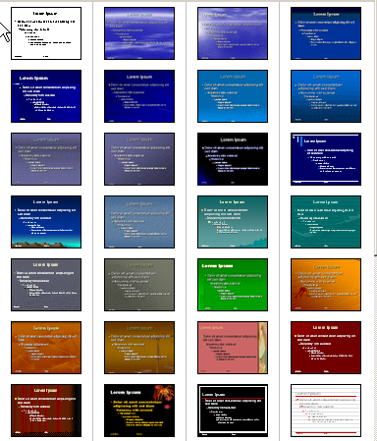
5. Have a visual theme, but avoid PowerPoint templates
Notes:
You can make your own background templates which will be more tailored to your needs. You can then save the PowerPoint file as a Design Template (.pot) and the new template will appear among your standard Microsoft templates for your future use.

Slide 40
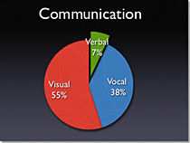

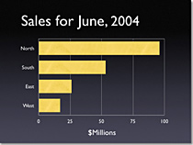

6. Use appropriate charts
Notes:
Always be asking yourself, "How much detail do I need?“
Emotional impact?
Pie Charts. Used to show percentages.
Vertical Bar Charts. Used to show changes in quantity over time.
Horizontal Bar Charts. Used to compare quantities.
Line Charts. Used to demonstrate trends.

Slide 41
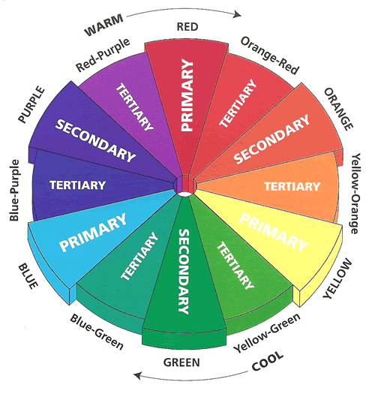
7. Use color well
Notes:
You do not need to be an expert in color theory, but it's good for business professionals to know at least a bit on the subject.
Colors can be divided into two general categories:
Cool (such as blue and green)
Warm (such as orange and red).
Cool colors work best for backgrounds
as they appear to recede away from us into the background.
Warm colors generally work best for objects in the foreground (such as text)
because they appear to be coming at us.

Slide 42
8. Choose your fonts well
Bullet A
Bullet B
Bullet C
Bullet D
Bullet E
Bullet F
Bullet G
Bullet 1
Bullet 2
Bullet 3
Bullet 4
Bullet 5
Bullet 6
Bullet 7
Notes:
Use the same font set throughout your entire slide presentation.
Use no more than two complementary fonts
Serif vs. sans serif
By the way, the bullet samples are all the same point size.

Slide 43

9. Use video or audio
Notes:
Using video clips to show concrete examples promotes active cognitive processing, which is the natural way people learn.
it will also serve as a change of pace thereby increasing the interest of your audience.
You may want to link the video to save yourself from having huge file sizes.
active cognitive processing: people understand the presented material when they
pay attention to the relevant material,
organize it into a coherent mental structure, and
integrate it with their prior knowledge.

Slide 44
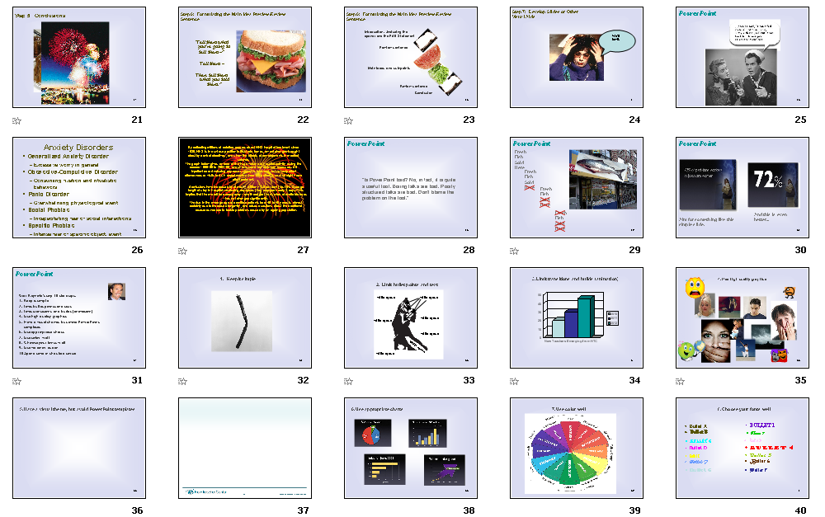
10. Spend time in the slide sorter
Notes:
According to the Segmentation Principle of multimedia learning theory, people comprehend better when information is presented in small chunks or segments. By getting out of the Slide View and into the Slide Sorter view, you can see how the logical flow of your presentation is progressing.
In this view you may decide to break up one slide into, say, two-three slides so that your presentation has a more natural and logical flow or process.
In this view you will be able to capture more of the gestalt of your entire presentation from the point of view of your audience.
You will be able to notice more extraneous pieces of visual data that can be removed to increase visual clarity and improve communication.
Anybody seeing some problem areas of this Slide Sorter View?

Slide 45
To Summarize…
How to deal with your energy
How to put the presentation together
How to make PowerPoint work for you
Notes:
We covered 3 areas in an effort to create dynamic presenters…
You
Your presentation
And Powerpoint
Always with the intent of keeping your audience as the primary focus.

Slide 46
How to deal with your energy
Organize
Visualize
Practice
Breathe
Focus on relaxing
Release tension
Move
Make eye contact

Slide 47
How to put the presentation together
Analyze your audience
Develop Objective and Position-Action-Benefit statement
Brainstorm main ideas
State the subpoints
Develop introductions and conclusions
Formulate the main idea preview/review sentence
Develop slides or other visual aids

Slide 48
How to make PowerPoint work for you
Keep it simple
Limit bullet points and text
Limit transitions and builds (animation)
Use high quality graphics
Have a visual theme, but avoid PowerPoint templates
Use appropriate charts
Use color well
Choose your fonts well
Use video or audio
Spend time in the slide sorter

Slide 49
We don’t pay attention to boring things
Stimulate more of the senses
Vision trumps all other senses
Notes:
“emotionally arousing events tend to be better remembered than neutral events.”
The more the brain pays attention to a given stimulus, the more elaborately the information will be encoded and retained.

Slide 50



Too many lists!
Restraint
Simplicity
Naturalness
Notes:
All these lists!
I’d like to leave you with 3 words…

Slide 51
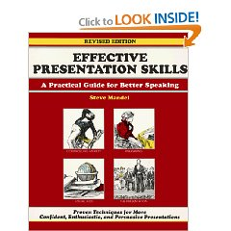






Thank you!
Click on these images for your reference.
Frank Widman
831-459-1269
fwidman@ucsc.edu
Notes:
Click on these pictures to go to web sites I’ve referenced in this presentation.

